Slide 1
School Values
COMPASSION
AMBITION
RESILIENCE
EXCELLENCE

Slide 2
Culture and Respect = Compassion

Slide 3
What is the opposite of Compassion?
Intolerance/Hatred

Slide 4
What happened this Summer….
Notes:
Who are asylum seekers?

Slide 5
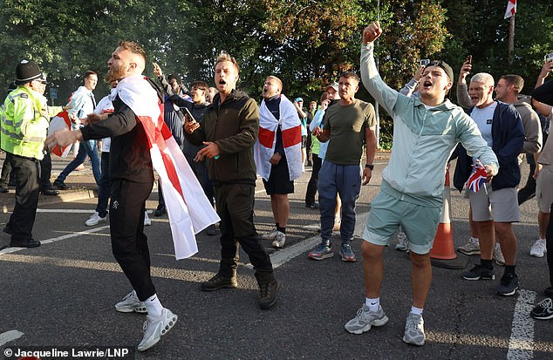
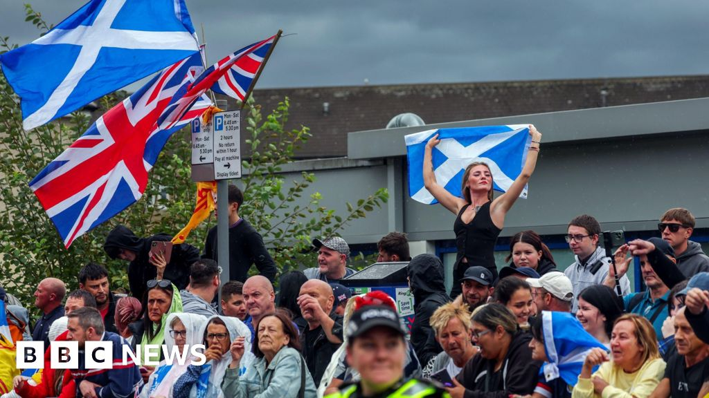
Far right demonstrations outside hotels..
Cheshunt
Falkirk
Notes:
Local people and other outside far right organisations, protesting outside hotels which are being used to house people who have had to escape their home country for various reasons. They are called asylum seekers or refugees.

Slide 6
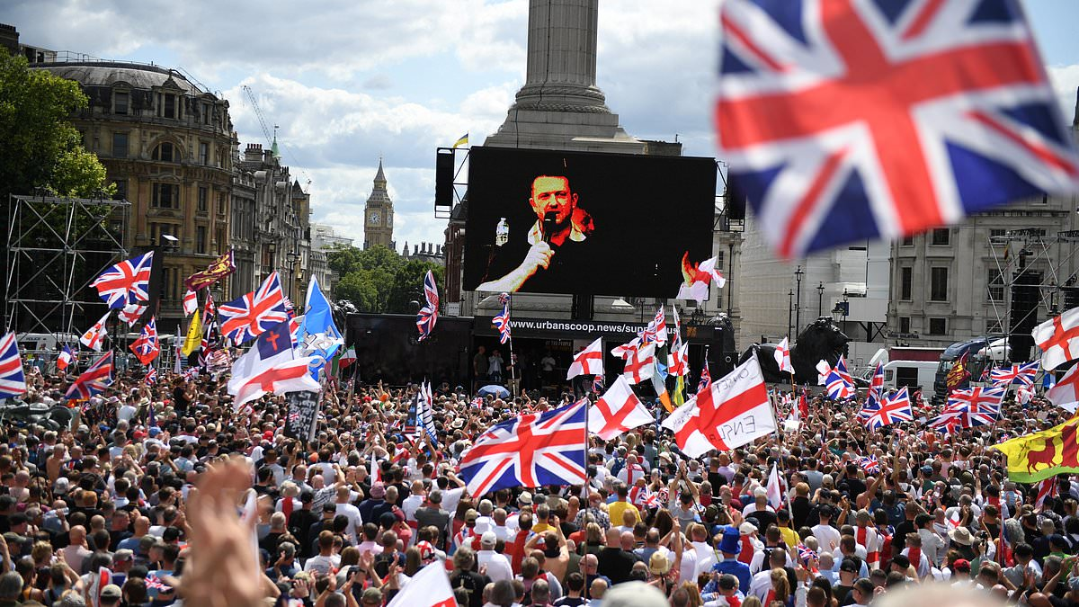
Far right demonstration on Saturday 13
There was a very large demonstration on Saturday in Central London around the phrase ‘Unite the Kingdom’ – it had many families on it, who may have different ideas about why they were there. However, everyone there knew that the demonstration was to promote ‘English’ people, over other groups, particularly Muslims and migrants.
The demonstration was organised by people with far right deeply racist politics.
People were seen doing Nazi salutes –Hitler was responsible for the murders of 12 million people, 6 million of them Jews in factories of death.

Slide 7
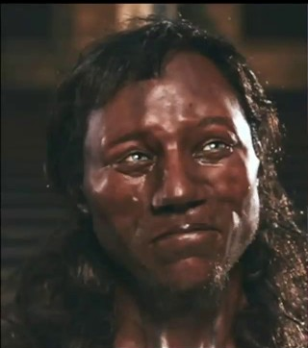
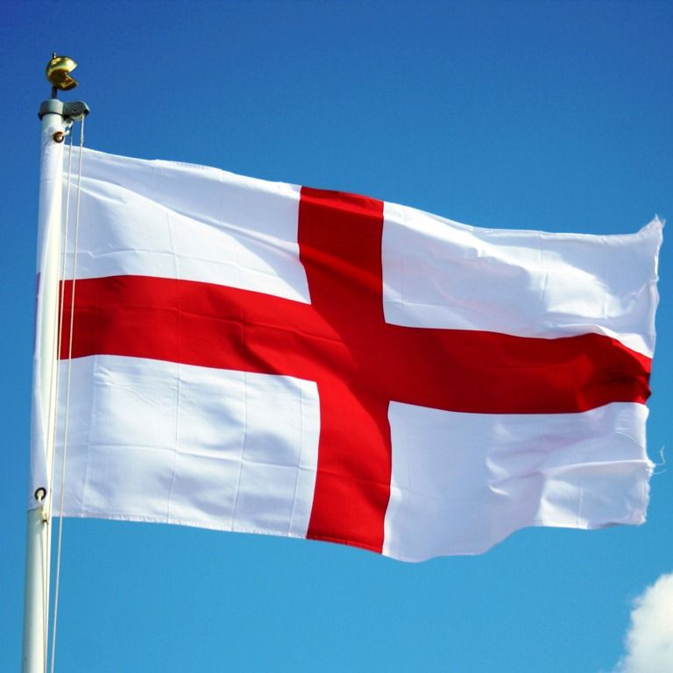
Who is English….
Oldest English man 11,000 years old….
England is made up of migrants throughout it’s history…whether the German Anglo Saxons, the Scandinavian Vikings, the French Normans, the Irish, the Jewish, people from the Caribbean, India, Africa, Turkey, Kurdistan etc…..
St George – born in Turkey with a Turkish dad and a Palestinian mother.

Slide 8
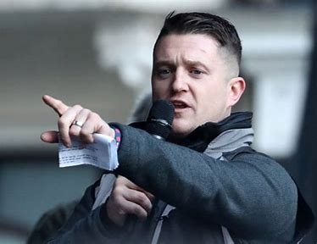
Who are the far right?
Tommy Robinson – Real name….Stephen Yaxley Lennon
He used to be in the British National Party – which was a racist party full of people who loved Hitler. So these people have been labelled Nazis, or the Italian version, Fascists…
He led the English Defence League – who hated Muslims and tried to march to the East London mosque. He has been arrested and taken to court and found guilty of telling lies about Muslims. He has also been found guilty of violent crimes.
There are other organisations who are on the far right – such as Britain First, and Patriotic Alternative, the Homeland party
They have many targets for their hate.
People fleeing their countries due to war, famine, hardship, refugees or ‘migrants’
Muslims
People of colour
LGBT+ people, particularly Trans people
Although more hidden, they also hate Jews.

Slide 9
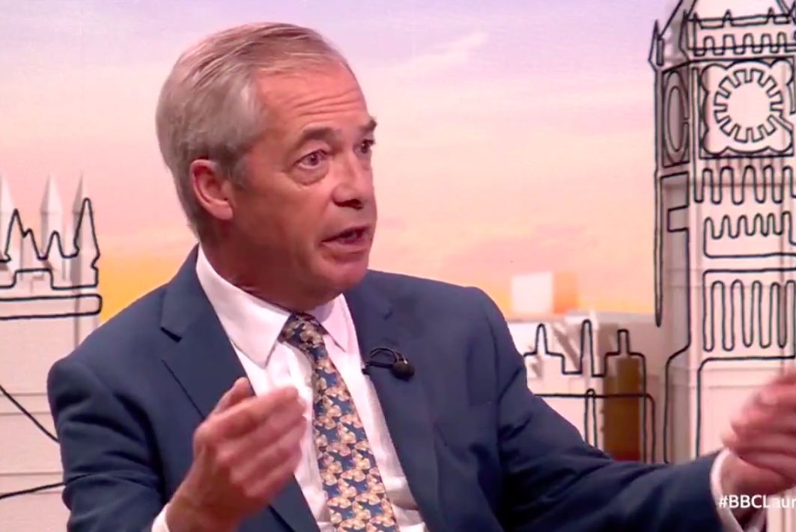
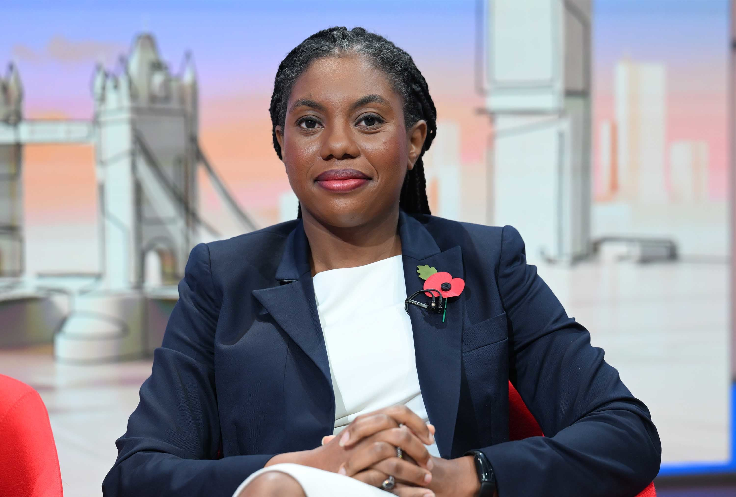
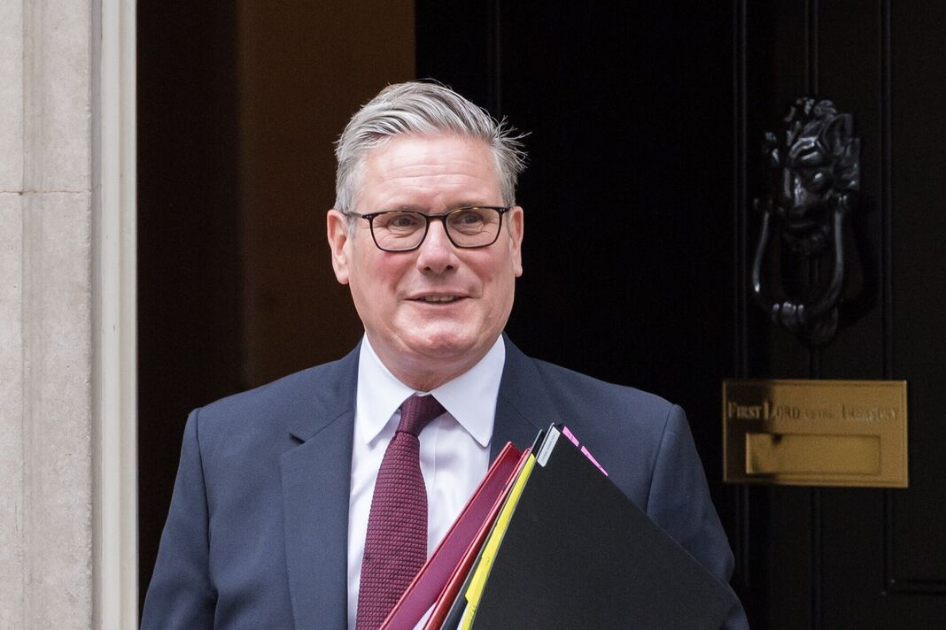
Unfortunately, many famous politicians are using language against others?
Nigel Farage – REFORM UK – Has argued that migrants are the reason people’s lives are getting harder, he wants to deport hundreds of thousands of people, and wants to get rid of all laws which prevent racism – in fact he’s a millionaire businessman, he had a German wife, and now has a French partner.
Kemi Badenoch– “not all cultures are equally valid” when it comes to deciding who should be allowed into the UK.
Keir Starmer – Immigration has done ‘incalculable damage’
Notes:
Windrush Generation were invited here to rebuild post-war Britain. No immigration, no NHS or care service, or food, music, art, culture.

Slide 10
Who are refugees?
Men, women and children often escaping war, famine, and just trying to have a safe life for themselves and their families.
Here are some refugee children…
Kids, refugees, questions: 'What is it like to have no home?'

Slide 11
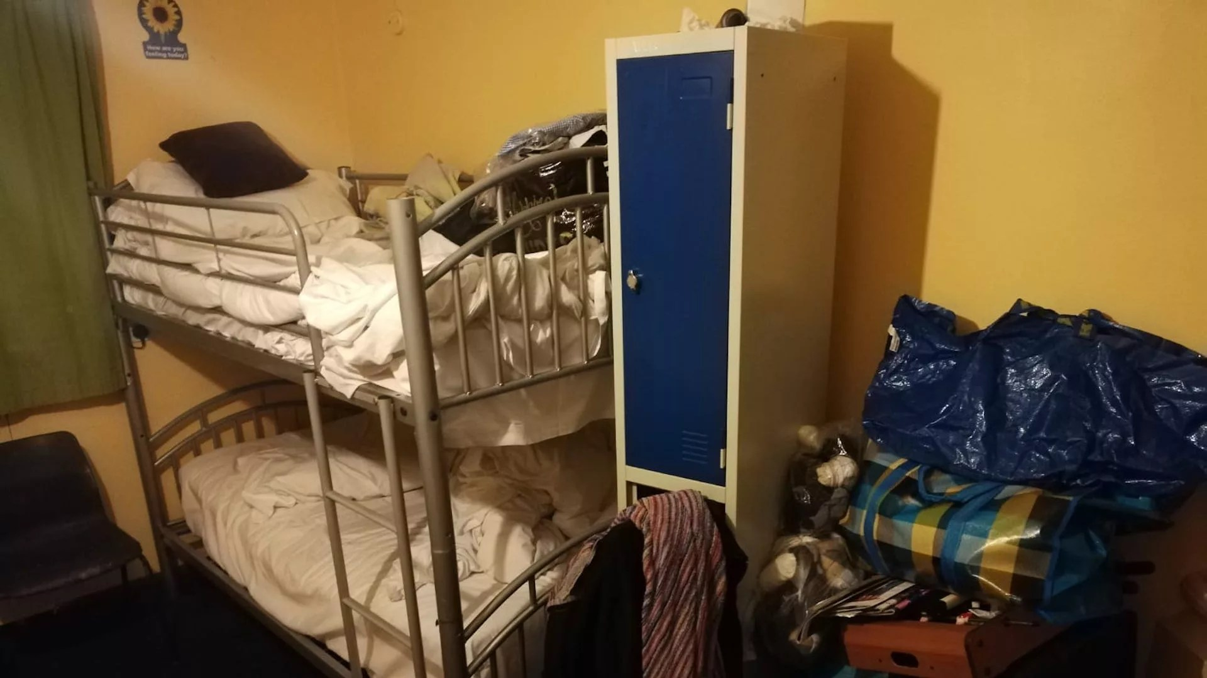
Some myths
Asylum seekers come here and take our jobs or…don’t want to work…
Fact – the government will not allow them to work, and so are forced to live on very low benefits. £49.18 a week
Asylum seekers take all the housing
Fact – There are 264,000 empty properties in London. Many owned by rich people as investments.
People come here illegally…
Fact – there are now no legal, safe routes for people to enter the UK, if they don’t have their papers. It is very hard when you are fleeing to carry your papers, and many people don’t have these things.
Migrants are using up NHS resources.
Fact – no migrants, no NHS – in the last 5 years, there were 50,000 new nurses appointed. 45,000 of them came from other countries, such as the Philippines, India and Ghana.
places like prisons
Asylum seekers get to stay in nice hotels.
Fact – the government forces them to stay in the hotels which are turned into places like prisons

Slide 12
What was the response of ordinary people to the protests outside the hotels
They showed compassion…..
Across the country thousands of people came out of their homes to defend their areas against those who wanted to spread hatred.
What was the response on Saturday to the racist demonstration called by Tommy Robinson?
20,000 anti racists turned out in Central London

Slide 13
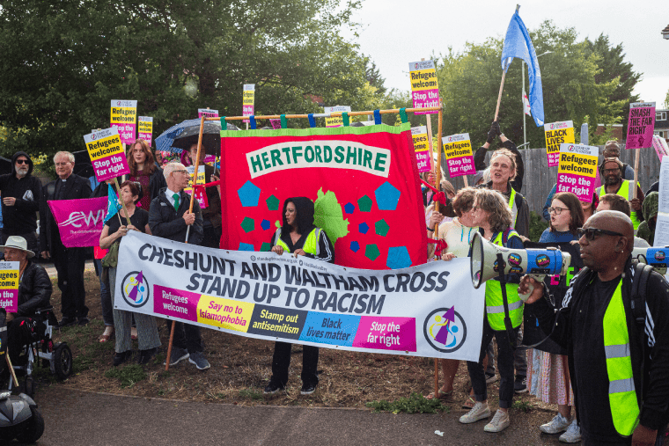
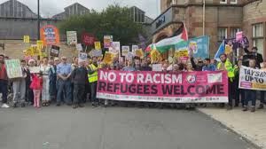
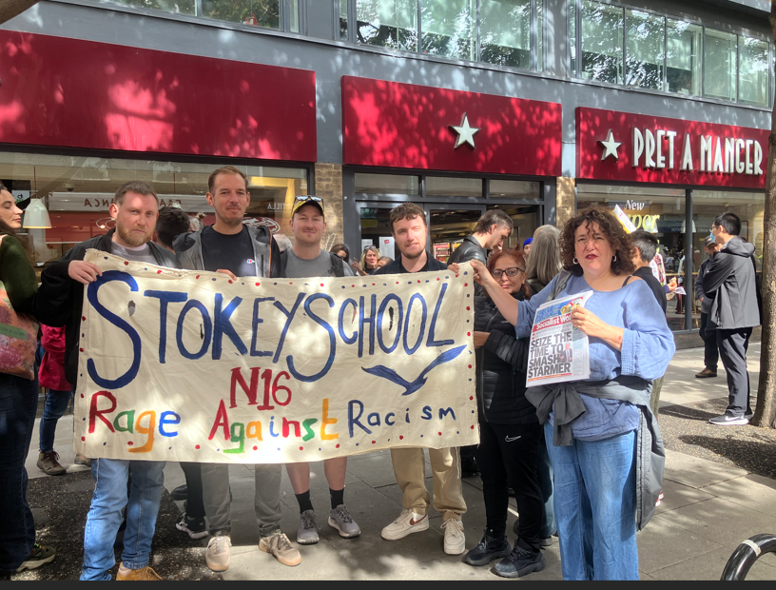
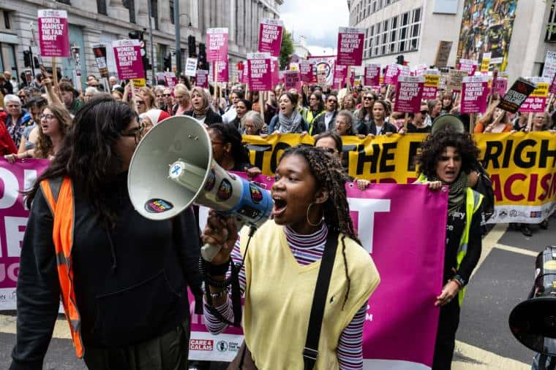
Resistance - compassion
Cheshunt
Falkirk
Saturday anti racist demonstration
Recognise anybody….
Notes:
Up and down the country compassionate anti-racists stood outside asylum seeker hotels showing solidarity with the refugees. Remember many of them are women and children. All of them have had a very dangerous and costly journey to escape their home countries.

Slide 14
What does compassion look like in SNS?
NEVER have words of hate in your mouth.
ALWAYS challenge language which picks on someone for their identity.
ALWAYS know you are not alone, and if you tell someone about discrimination, something will be done.
ALWAYS stand up for what is right. You feel better, and so do the people around you.

