Slide 1
What is happening to British politics….

Slide 2
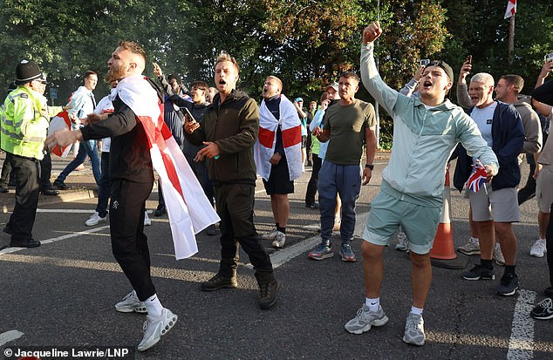
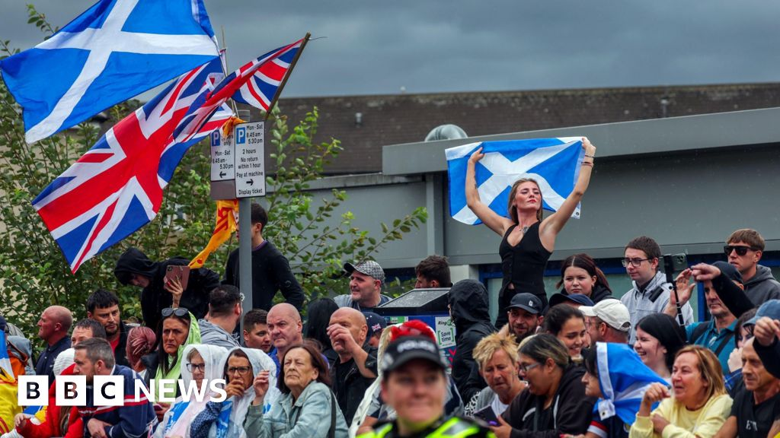
Far right demonstrations this Summer outside hotels housing asylum seekers
Cheshunt
Falkirk
Notes:
Many smaller towns such as Portsmouth, Nottingham, etc…but also much closer to home…Islington, Epping, Canary Wharf

Slide 3
Over the Summer there was the Raise the Colours
Flags represent all sorts of things (my background flag).
What was the Raise the Colours campaign about?
Was the Cross of St George flag being hoisted to make all people in this country feel proud about being British?
Or was it used to promote and celebrate one group of the community, the white English?
Is it to unite or divide?

Slide 4
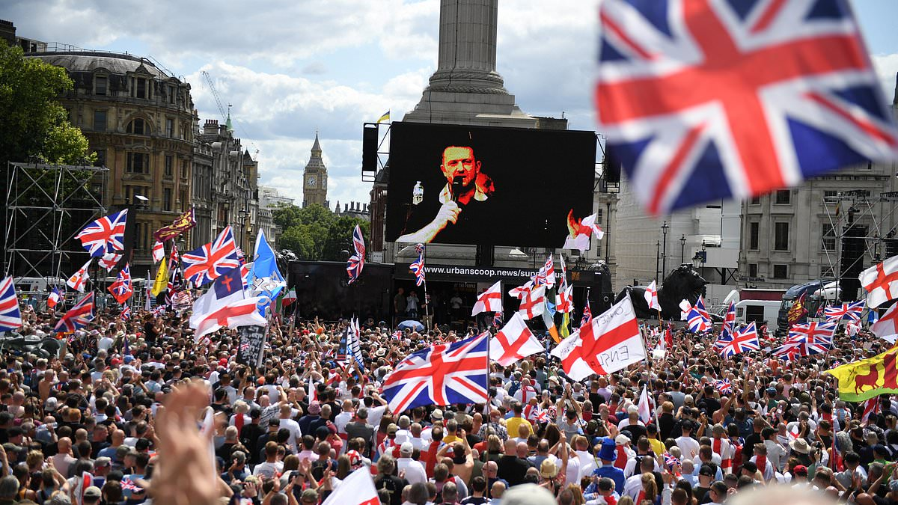
Far right demonstration on Saturday 13
There was a very large demonstration on Saturday in Central London – it had many families on it, who may have different ideas about why they were there. They all would have been aware that the demonstration was to promote ‘English’ people, over other groups, particularly Muslims and migrants.
The people who organised the demonstration go beyond racism and have fascist politics. Organisations such as such as Patriotic Vanguard, the Homeland party, and all brought together by Tommy Robinson who I’ll talk about in a minute.
People were seen doing Nazi salutes – REMEMBER Hitler was responsible for the murders of 12 million people, 6 million of them Jews in factories of death.
Send them back, Stop the Boats, Hitler is a hero., we want our country back…

Slide 5
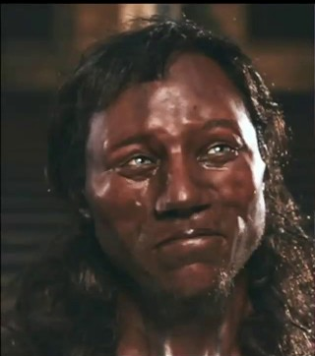
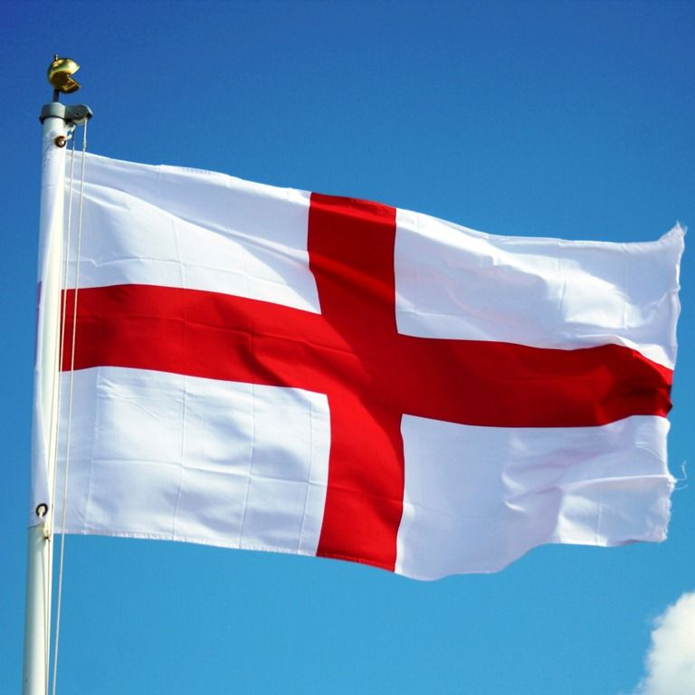
Who is English….
Oldest English man 11,000 years old….
England is made up of migrants throughout it’s history…whether the German Anglo Saxons, the Scandinavian Vikings, the French Normans, the Irish, the Jewish, people from the Caribbean, India, Africa, Turkey, Kurdistan etc…..
St George – born in Turkey with a Turkish dad and a Palestinian mother.

Slide 6
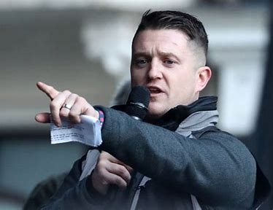
Who are the far right?
Tommy Robinson – Real name….Stephen Yaxley Lennon
He used to be in the British National Party – which was a racist party full of people who loved Hitler.
He led the English Defence League – who hated Muslims and tried to march to the East London mosque. He has been arrested and taken to court and found guilty of telling lies about Muslims. He has also been found guilty of violent crimes.
As I’ve mentioned there are other organisations on the far right who helped organise the demonstration.
They have many targets for their hate.
People fleeing their countries due to war, famine, hardship, refugees or ‘migrants’
Muslims
People of colour
LGBT+ people, particularly Trans people
Although more hidden, they also hate Jews.

Slide 7
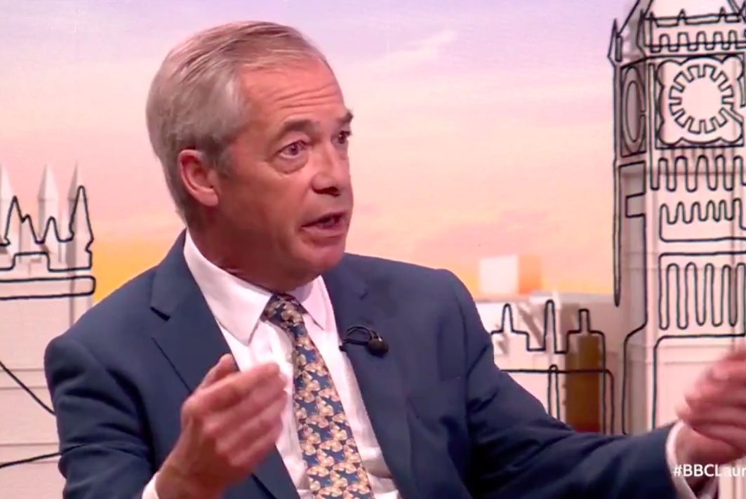
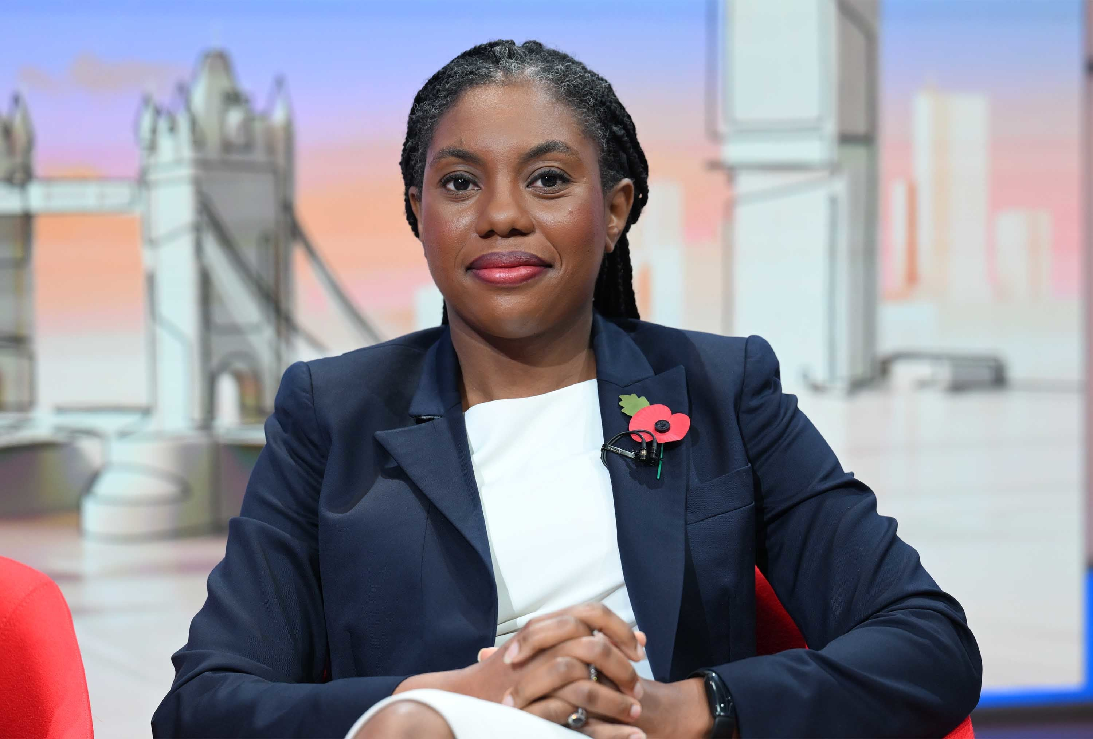
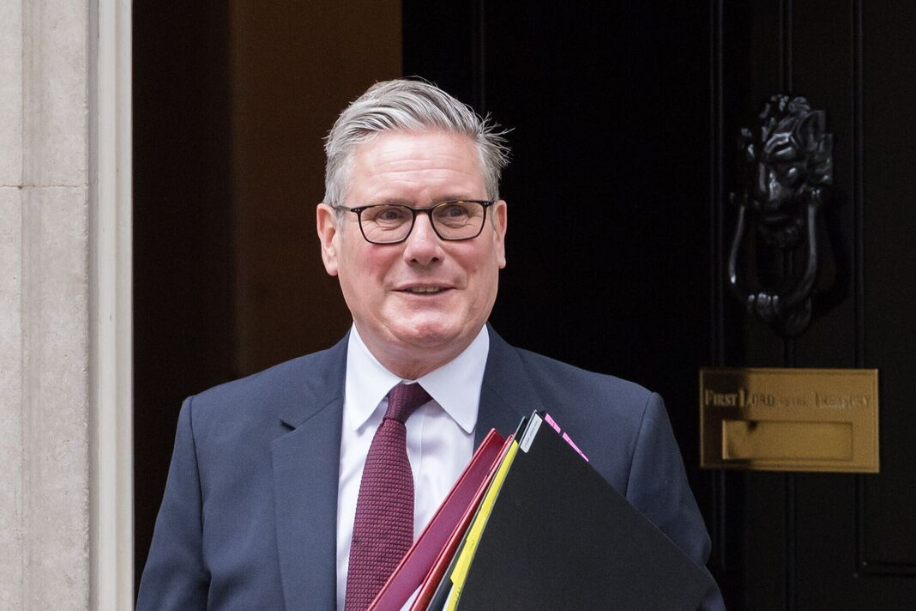
Who else uses divisive language which is boosting the far right?
Nigel Farage – REFORM UK – Has argued that migrants are the reason people’s lives are getting harder, he wants to deport hundreds of thousands of people, and wants to get rid of all laws which prevent racism – in fact he’s a millionaire businessman, he had a German wife, and now has a French partner.
Kemi Badenoch– “not all cultures are equally valid” when it
comes to deciding who should be allowed into the UK.
Keir Starmer – Immigration has done ‘incalculable damage’
Notes:
Windrush Generation were invited here to rebuild post-war Britain. No immigration, no NHS or care service, or food, music, art, culture.

Slide 8
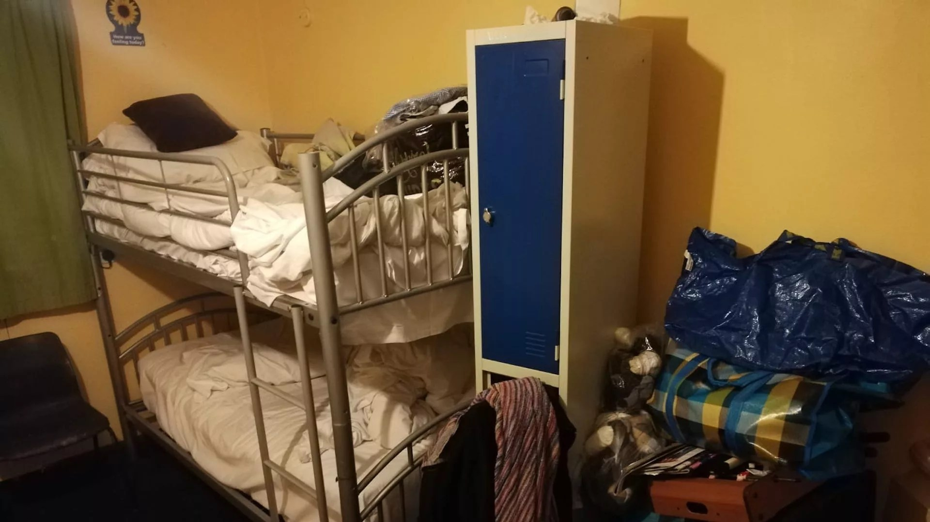
Some myths
Asylum seekers come here and take our jobs or…don’t want to work…
Fact – the government will not allow them to work, and so are forced to live on very low benefits. £49.18 a week
Asylum seekers take all the housing
Fact – There are 264,000 empty properties in London. Many owned by rich people as investments.
People come here illegally…
Fact – there are now no legal, safe routes for people to enter the UK, if they don’t have their papers. It is very hard when you are fleeing to carry your papers, and many people don’t have these things.
Migrants are using up NHS resources.
Fact – no migrants, no NHS – in the last 5 years, there were 50,000 new nurses appointed. 45,000 of them came from other countries, such as the Philippines, India and Ghana.
Asylum seekers get to stay in nice hotels.
Fact – the government forces them to stay in the hotels which are turned into places like prisons

Slide 9
Some myths
The far right are protecting women and children from ‘Asian’ grooming gangs
Fact - according to police statistics the vast majority of grooming gangs involve white men.
Fact - In 2024 of those arrested – 40% of the people domestic violence charges, and a number had convictions for paedophilia.

Slide 10
Why does anyone listen to this stuff?
Cost of living crisis – food being so expensive
Heating homes being so expensive.
Lack of affordable housing
Shortage of NHS care
People who are suffering want someone to blame….and unfortunately our governments have spent a lot of time pointing at migrants who come with nothing…who have not put up food prices, or fuel prices, or rents, or made the NHS struggle…

Slide 11
What was the response of ordinary people to the protests outside the hotels
Across the country thousands of people came out of their homes to defend their areas against those who wanted to spread hatred.
What was the response on Saturday to the racist demonstration called by Tommy Robinson?
20,000 anti racists turned out in Central London

Slide 12
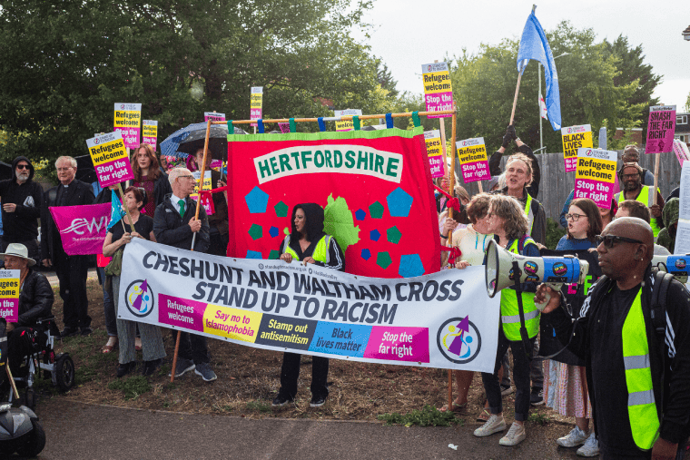
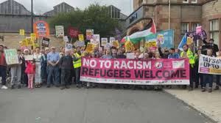
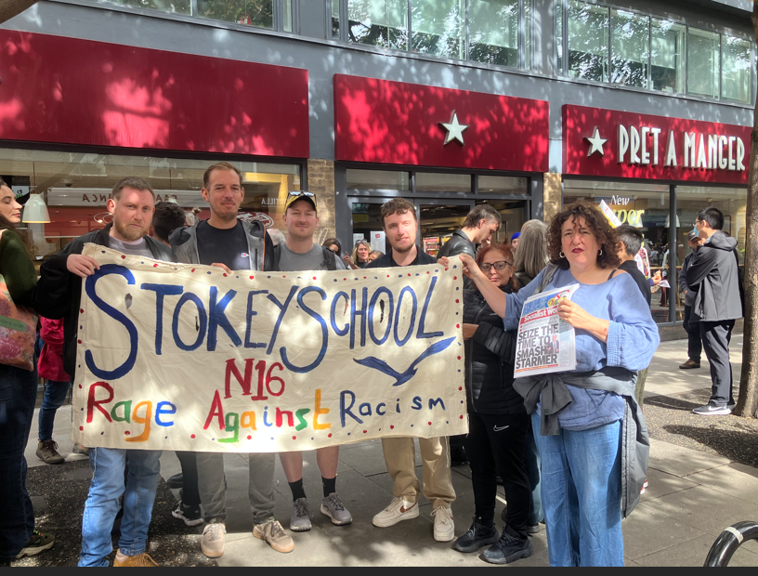
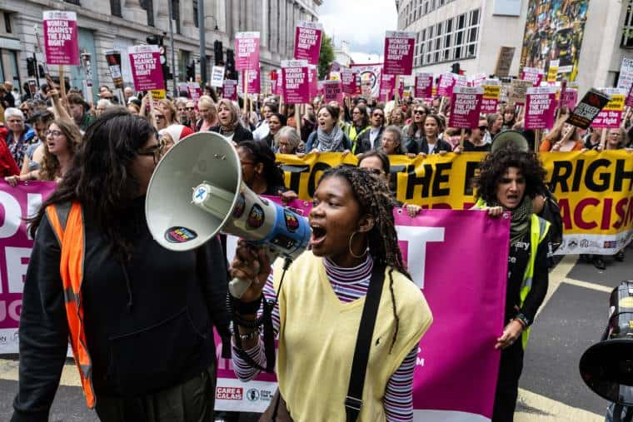
There is always resistance…
Cheshunt
Falkirk
Stand Up to Racism Demo – Saturday 13
Some people you may recognise..
Notes:
Up and down the country compassionate anti-racists stood outside asylum seeker hotels showing solidarity with the refugees. Remember many of them are women and children. All of them have had a very dangerous and costly journey to escape their home countries.

Slide 13
Not spontaneous
People didn’t just come out of their houses at the same time, to go to the same place by chance. People in many groups put the call out. Stand up to Racism, Trade unions, (including the education union), churches, mosques, synagogues…
What we do makes a difference.

Slide 14
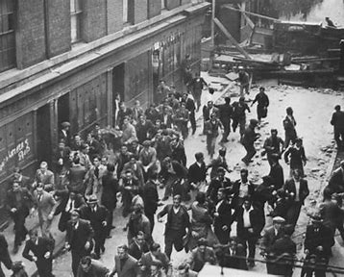
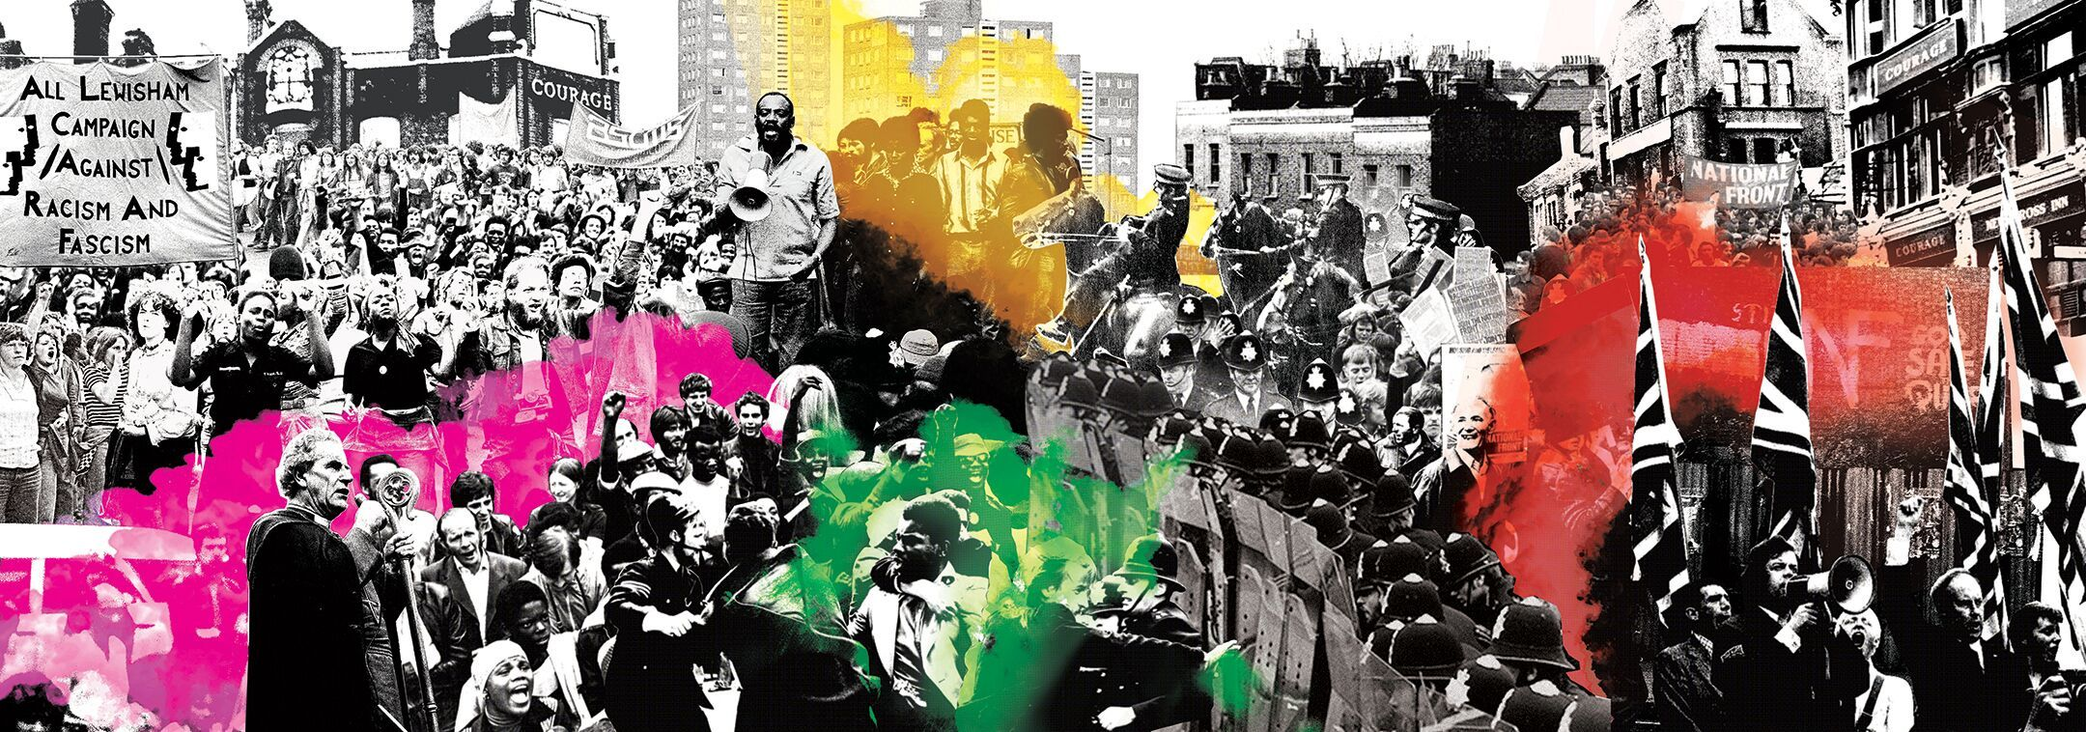
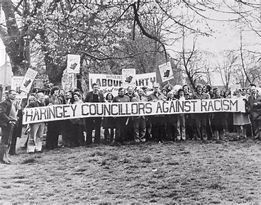
History of this resistance to racism
Cable Street 1936 – 300,000 Irish dockers, Jews, Socialists, Communists, Trade Unionists… and others gathered to stop the British Hitler – Oswald Mosley. The British Union of Fascists, never as strong again.
Lewisham 1977 – 4000 anti-racists met 500 of the National Front
and they were never as strong again
Wood Green 1977 –3000 anti racists met the National Front, and
they were forced to leave.
Nick Griffin BNP election - 2010….Barking and Dagenham 2010
defeated as many anti-racists knocked on doors urging people not to
vote for this man.

Slide 15
Be aware, we are facing the biggest racist demonstration which has ever happened in this country.
How did the previous anti-racist movements stop the growth of the far right?
They drove a wedge between the hardcore fascist minority and their racist audience.
This means involving as many people as possible in the protests, so they feel isolated, AND exposing them to their audience.
Notes:
Cheshunt

Slide 16
What do we need to do….
We have to be part of and try to mobilise the majority of anti-racist people in this country.
A lot of the information online about minority groups is not true. Check facts.
What we do makes a difference…
ALWAYS challenge language which picks on someone for their identity.
ALWAYS know you are not alone, and if you tell someone about discrimination, something will be done.
ALWAYS stand up for what is right. You feel better, and so do the people around you.
Notes:
Think about the nearly million people who have expressed an interest in the left wing Your Party with Zara Sultana and Jeremy Corbyn.
Think about the hundreds of thousands who protest every month over what’s happening in Gaza.

Slide 17
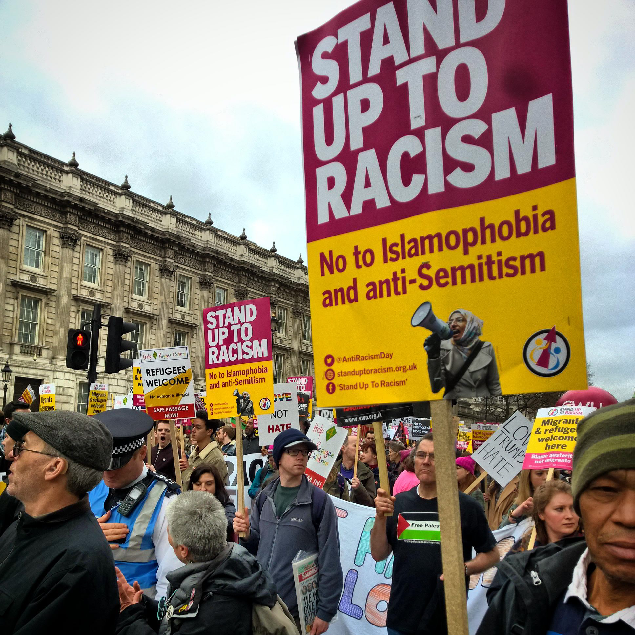
We are the majority……
But we need to act!
Stand up to Racism

